Slide 1




TEAM 5095 PRESENTS
DECEMBER 15. 2025
TASTE OF
HARLEM
A LOCAL RESTAURANT ORDERING & DELIVERY SYSTEM
ANGUS CHEN
BRIANNA HAYLES
JING HAN LIN
DIANA LUCERO
ALISHA MUGHAL
KRISTA U SINGH

Slide 2



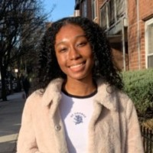



Meet The Team
Angus Chen
Diana Lucero
FRONTEND
BACKEND
Handled the user interface and experience using Next.js (React), TypeScript, JavaScript, and Tailwind CSS.
Utilized Python (FastAPI) and raw SQL queries to manage user authentication, order processing, and business logic.
Brianna Hayles
Alisha Mughal
BACKEND
PROJECT MANAGEMENT
Utilized Python (FastAPI) and raw SQL queries to manage user authentication, order processing, and business logic.
Oversees and coordinates the development process.
Jing Han Lin
Krista U. Singh
DATABASE
DATABASE
Managed the MySQL system hosted on AWS RDS and defining the complex entity relationships and raw SQL queries for data access.
Managed the MySQL system hosted on AWS RDS and defining the complex entity relationships and raw SQL queries for data access.

Slide 3
Our Mission
Taste of Harlem is a full-stack web app that connects customers, local restaurants, and delivery drivers in one simple platform.

Slide 4

Overall Business Idea & Service
RESTAURANT STAFF
DELIVERY DRIVERS
CUSTOMERS
Order food simply and quickly.
Can accept and complete deliveries.
Manage menus, orders, and revenue without high third-party fees.

Slide 5
Tech Stack
FRONTEND | BACKEND | DEVOPS & DEPLOYMENT
Framework: Next.js (React) | Framework: FastAPI (Python) | Containerization: Docker
Language: TypeScript, JavaScript Styling: Tailwind CSS | Database: MySQL (hosted by AWS RDS) | Version Control: GitHub
Purpose: Handle user interface and experience | Purpose: Manages business affairs and user authentication | Cloud Hosting: AWS RDS for database and deploying the app

Slide 6
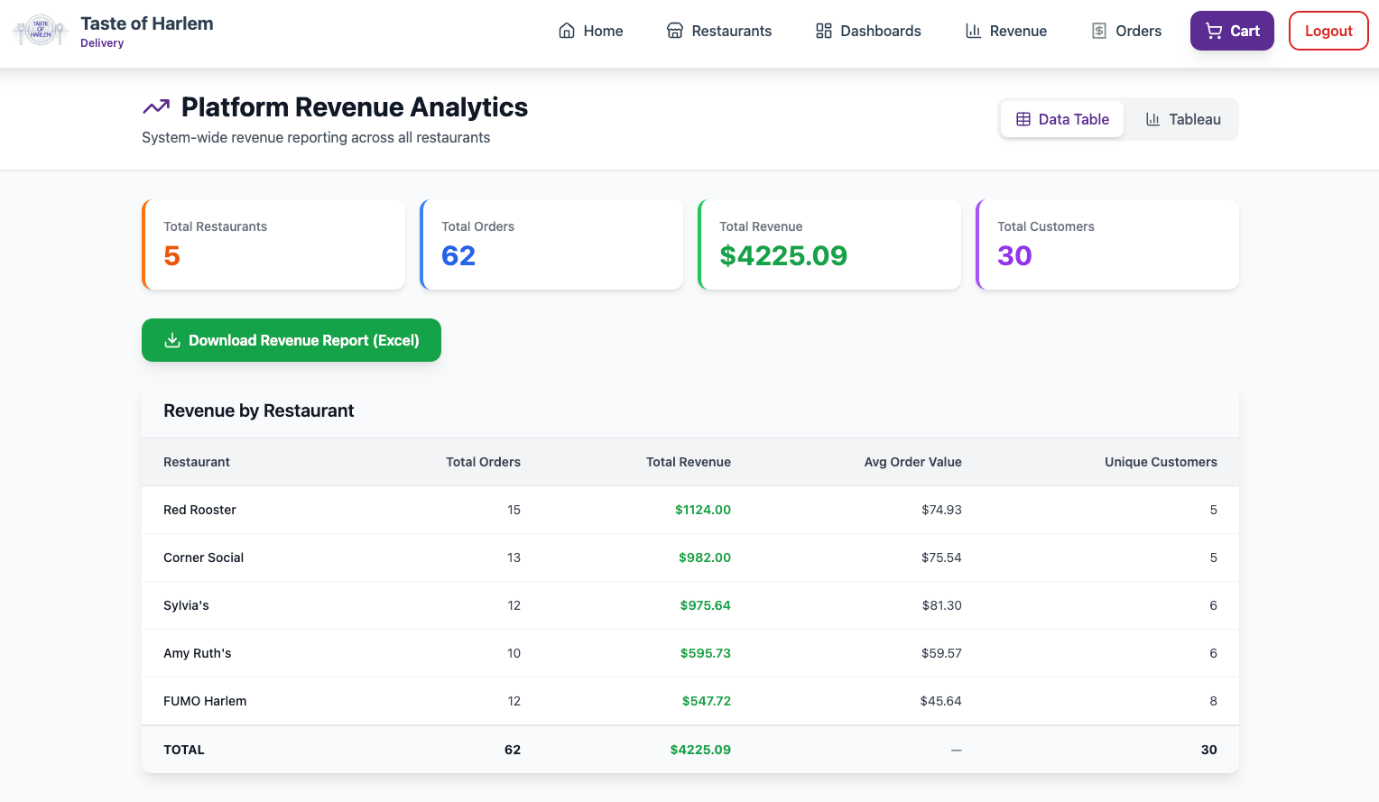
Profit Model
DELIVERY FEES (FLAT RATE- $3.99)
SERVICE FEES (FLAT RATE - $2.99)
RESTAURANT COMMISSION (75% OF EARNINGS)
DELIVERY DRIVERS (10% OF EARNINGS)
TASTE OF HARLEM COMMISION (15% OF SUBTOTAL, 15% OF DELIVERY, ENTIRE SERVICE FEE)

Slide 7

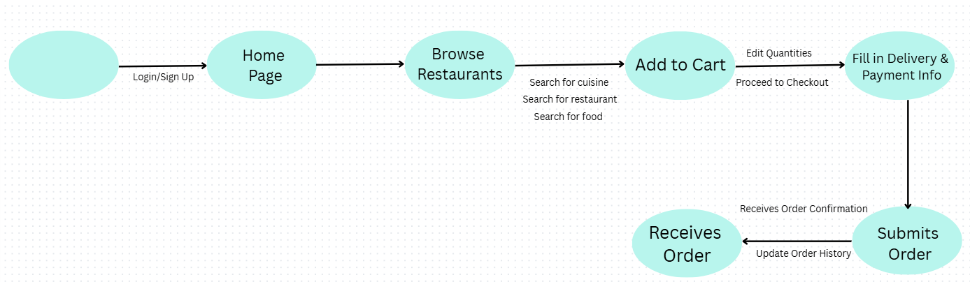

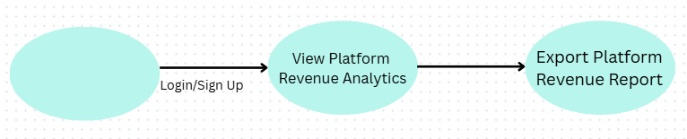
Use Cases
CUSTOMERS
RESTAURANTS
INVESTORS

Slide 8
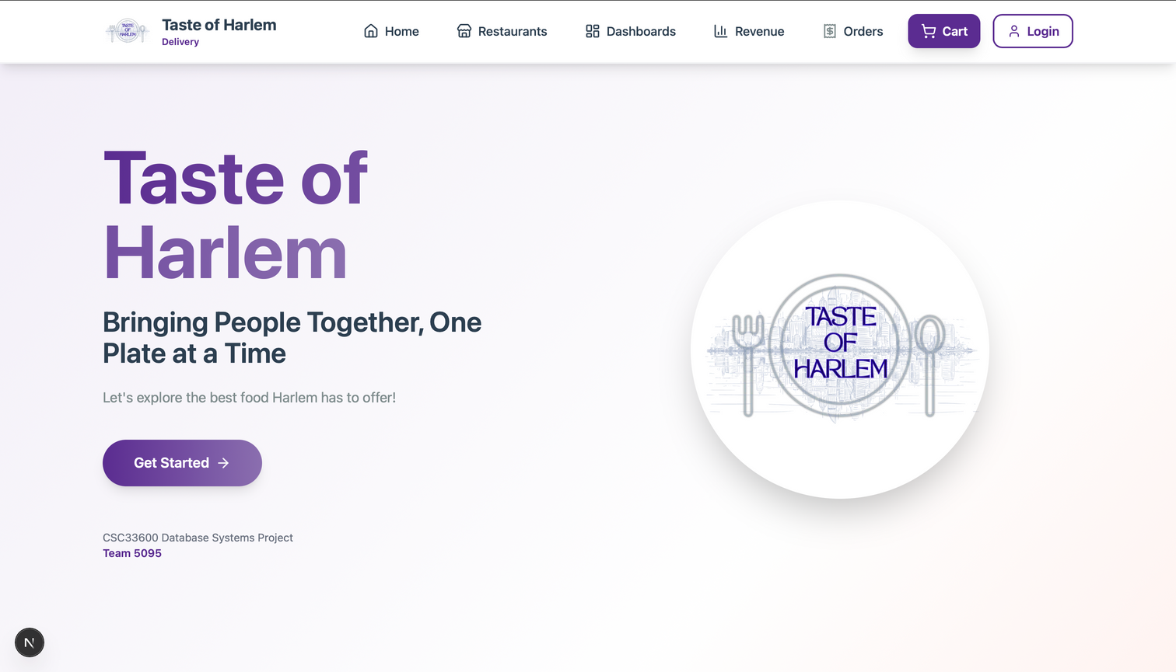
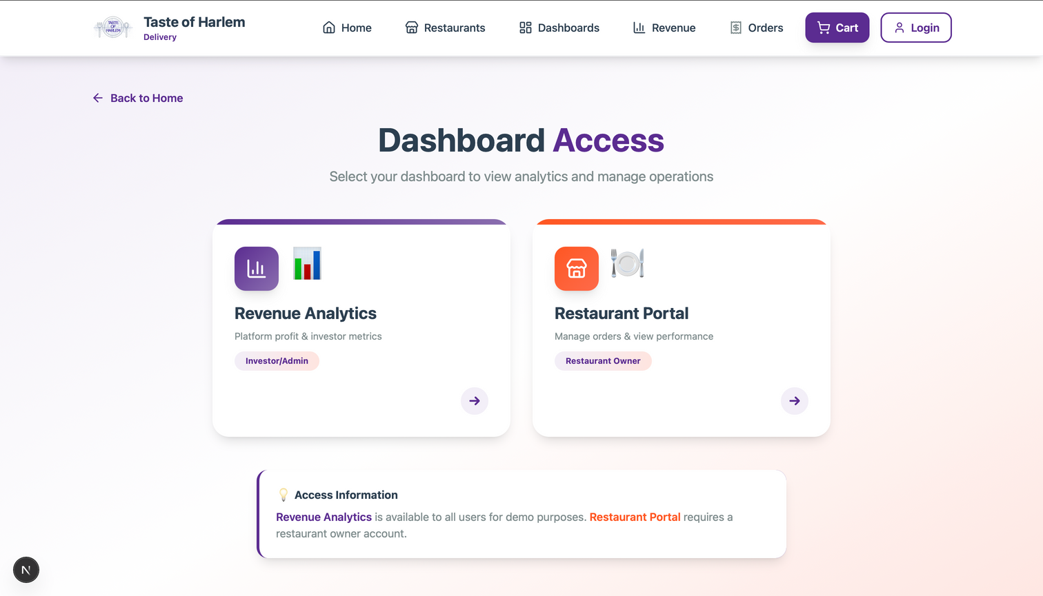
Landing Page Demonstration

Slide 9
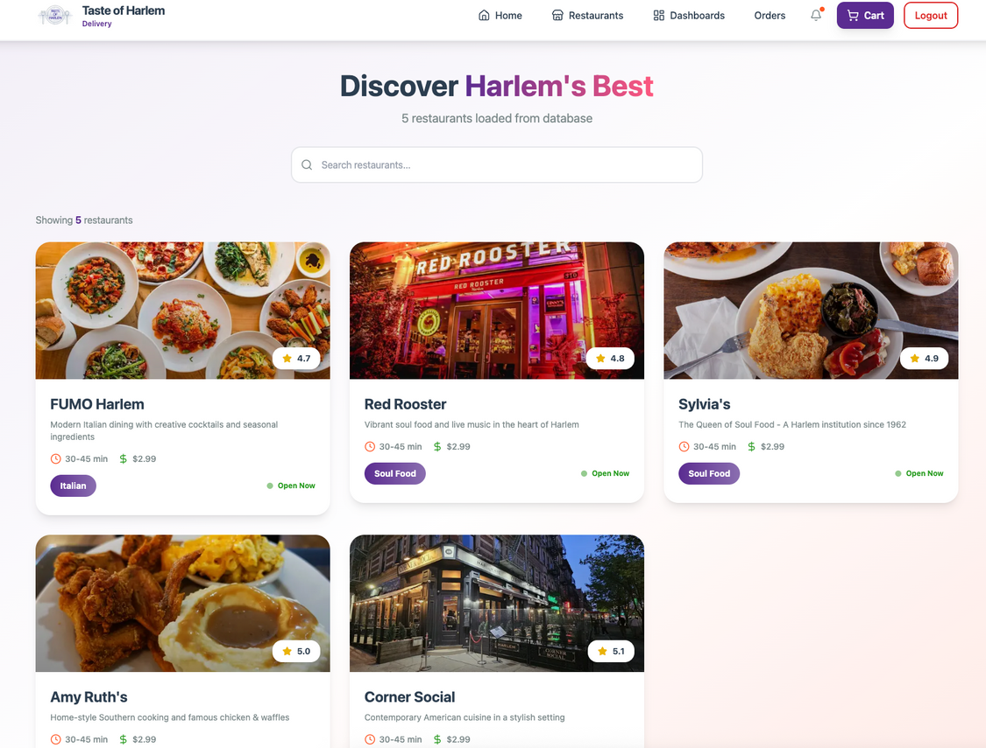
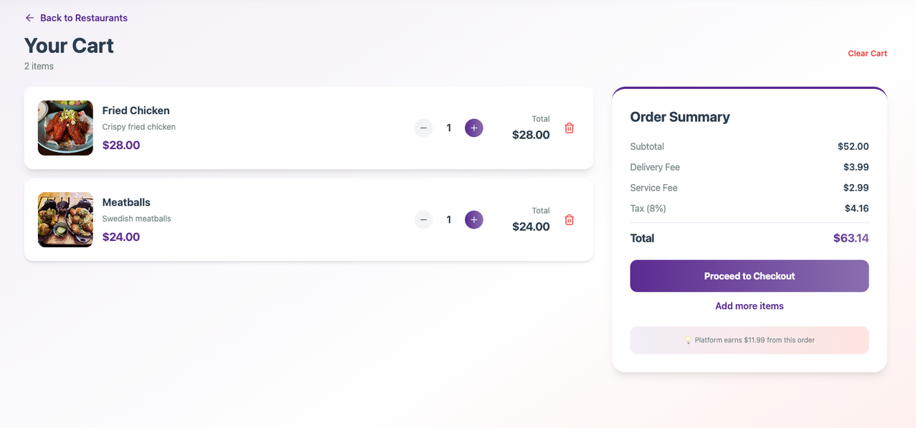
User Action Demo

Slide 10
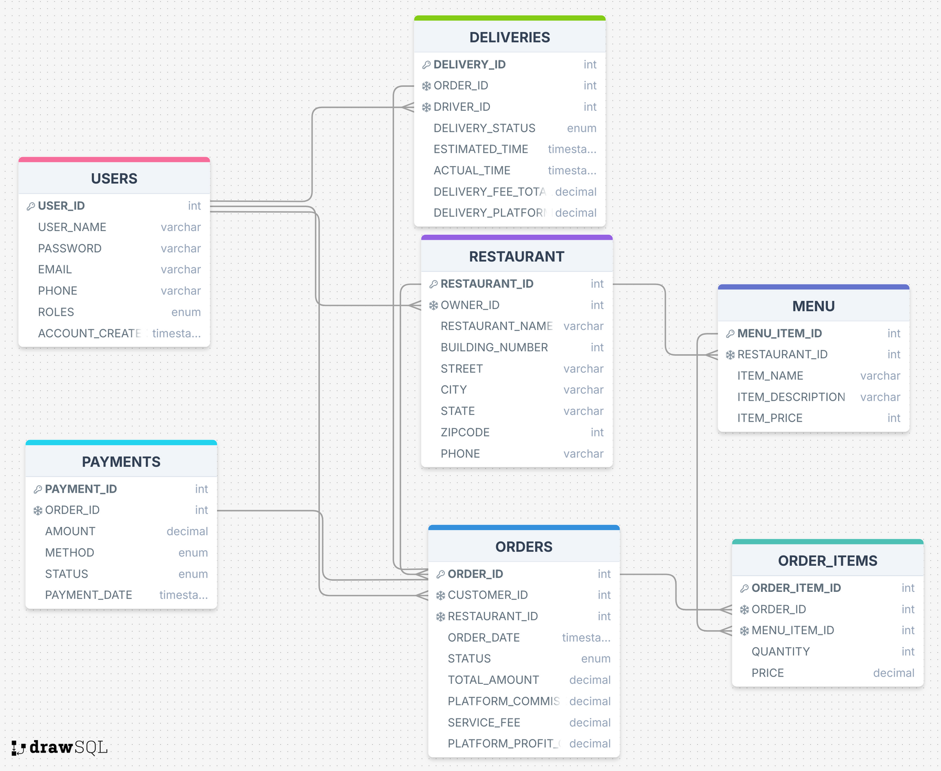
2NF Relational Model Diagram

Slide 11
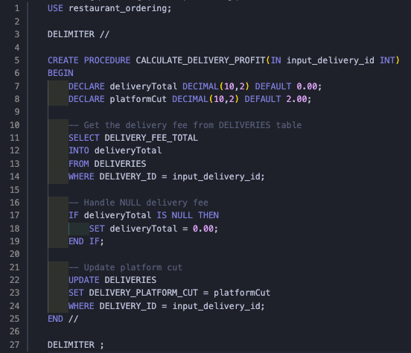
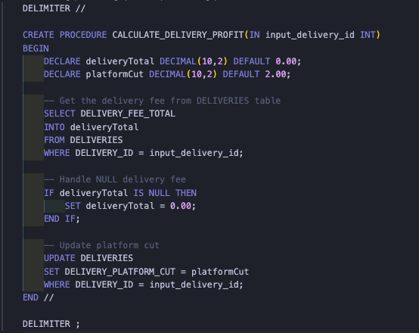
Stored Procedure Demonstration

Slide 12
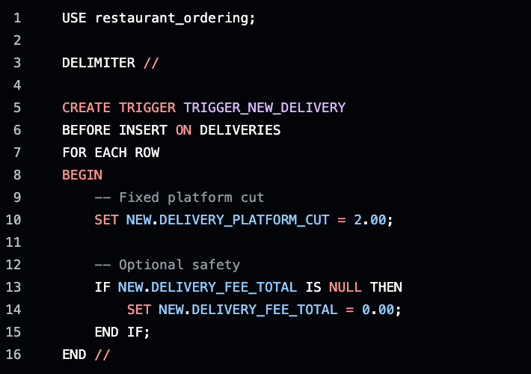
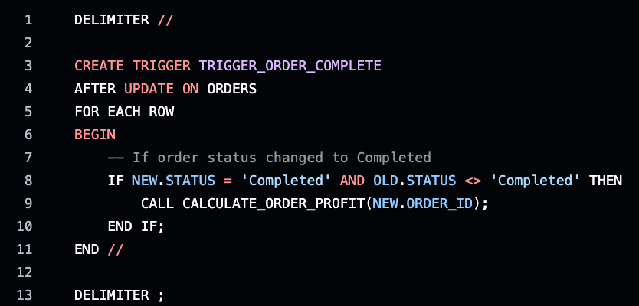
Triggers Demonstration

Slide 13
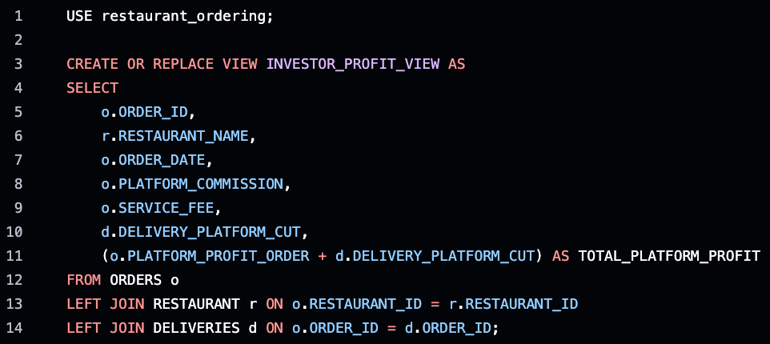
Investor Profit View

Slide 14
Takeaways
1 | 2 | 3
Describe a new technology you used this semester and explain why you found it especially useful or not useful at all | Explain how the dynamic database project exercises helped you better understand relational databases or cleared up any previous misconceptions. | Share an “aha” moment from your group project that you think could be applied in future classes to benefit many other students.
Docker was utilized for containerization to ensure that environments were consistent for all development stages. AWS RDS (MySQL) was used to host and scale our database in the cloud for RDMS. | We were able to gain a better understanding of how much relational databases rely on strictly enforced foreign key constraints and cardinality between tables, which prevents data that is inconsistent. | Our group’s “aha” moment was realizing that it’s best for all of us to come to a consensus for the API and schema because it would have prevented delays and integration challenges.

Slide 15

Extra Credit
UTILIZING FREE CLOUD SERVICES (AWS)
CREATING A USER-FRIENDLY, UX-FOCUSED WEB UI.
IMPLEMENTING DYNAMIC REPORTING WITH BI/ANALYTICS TOOLS TABLEAU)

Slide 16
THANK YOU!
ANY QUESTIONS? EXAMINATIONS?

